Slide 1
Vehicle Loan Default Prediction
Guided by
Team Details
Animesh Tiwari
Abhilash SR
Krishnamurthy S
Krishnaraj Palanychamy
Prabhakaran S
Pravin Kumar S
Vishwanath Kannan

Slide 2
Abstract
People avail vehicle loan from banks to buy their dream cars. Car loans have taken off in India witnessing an increase in growth of 18-20% which is a huge increase in 2019.
Bank and vehicle finance companies are making this dream come true by providing the vehicle loan facility.
Indian Banks has lost 200 Crore Rupees each year due to defaulters.
Financing a vehicle involves a lot of technicalities like the kind of vehicle to be financed, the route on which the vehicle will be plying, the operating expenses of the customer, etc.
It is also being influenced by processing fee, loan clearance time, requirement of documentation and methodology being followed in computation of interest.

Slide 3
Problem Definition
Reduce bad loans by filtering out potential defaulting customers and identify potential non-defaulters so as to offer good LTV for their loan.
We are using ML algorithms to predict whether up to a statistical degree whether or not he/she will default in his/her first EMI payment.

Slide 4
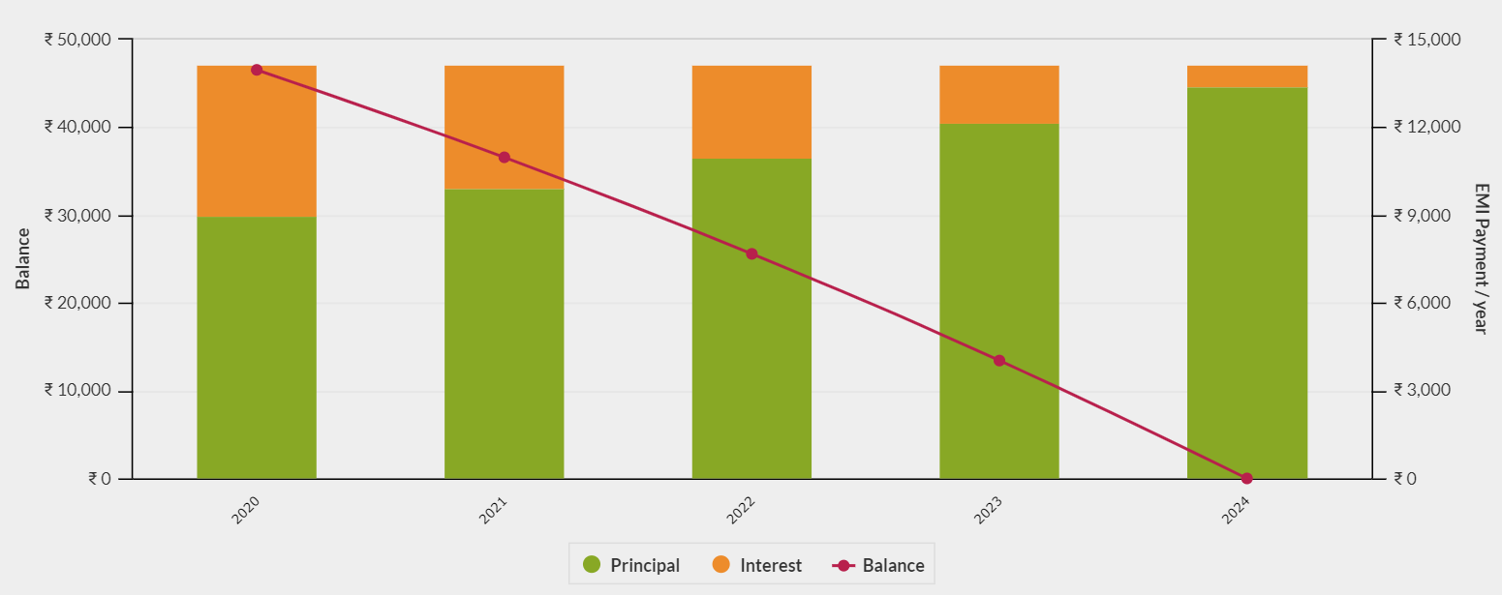
EMI Payment Schedule
Source: emicalculator.net

Slide 5
Data Dictionary:
https://www.kaggle.com/mamtadhaker/lt-vehicle-loan-default-prediction
The Dataset contains 233154 Rows and 41 Columns
14 Numerical columns,2 Datetype columns and 25 Categorical columns
The Only column with missing values is Employment Type. It has 7661 missing values which is about 3.3% of the data
Current Balance has 1,50,000 Entries as zero, out of which 70,000 entries have applied for their first loan

Slide 6
Current Loan
Disbursed Amount
Asset Cost
Loan to Asset ratio(ltv)
Document Submitted
Aadhar Flag
Passport Flag
Driving License Flag
Mobile No Avl. Flag
PAN Flag
Voter ID Flag
Primary Account Information
Pri. No. of Accounts
Pri. Active Account
Pri. Overdue Account
Pri. Current Balance
Pri. Sanctioned Balance
Pri Disbursed Amount
Pri Installment Amount
Bureau Information
CNS Score Description
CNS Score
Disbursing Bank Information
Branch ID Supplier ID
Manufacture ID Current PINCODE ID
State ID
Employee Code ID
Mo
Date Information
Disbursal Date
Credit History Length
Average Account Age
Secondary Account Information
Sec. Number of Accounts
Sec. Active Account
Sec. Overdue Account
Sec. Current Balance
Sec. Sanctioned Balance
Sec Disbursed Amount
Sec Installment Amount
Other Customer Information
Date of Birth
New Accounts In Last 6 months
Delinquent Accounts in 6 months
No Of Inquires
Loan Default (Target Variable)

Slide 7
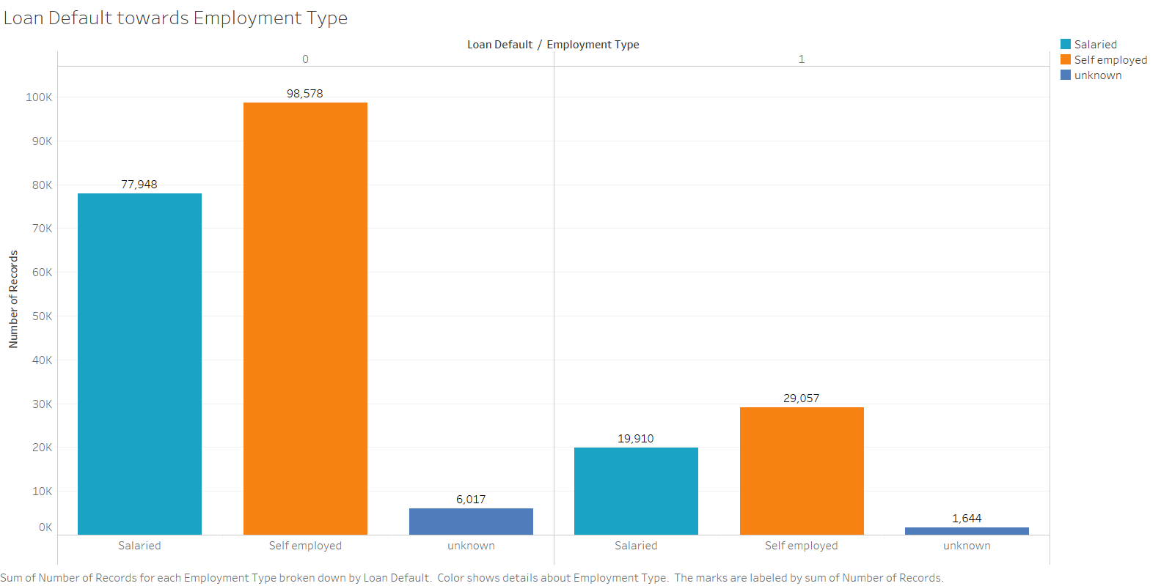
Loan Default from Employment Type
Not Defaulted
Defaulted

Slide 8
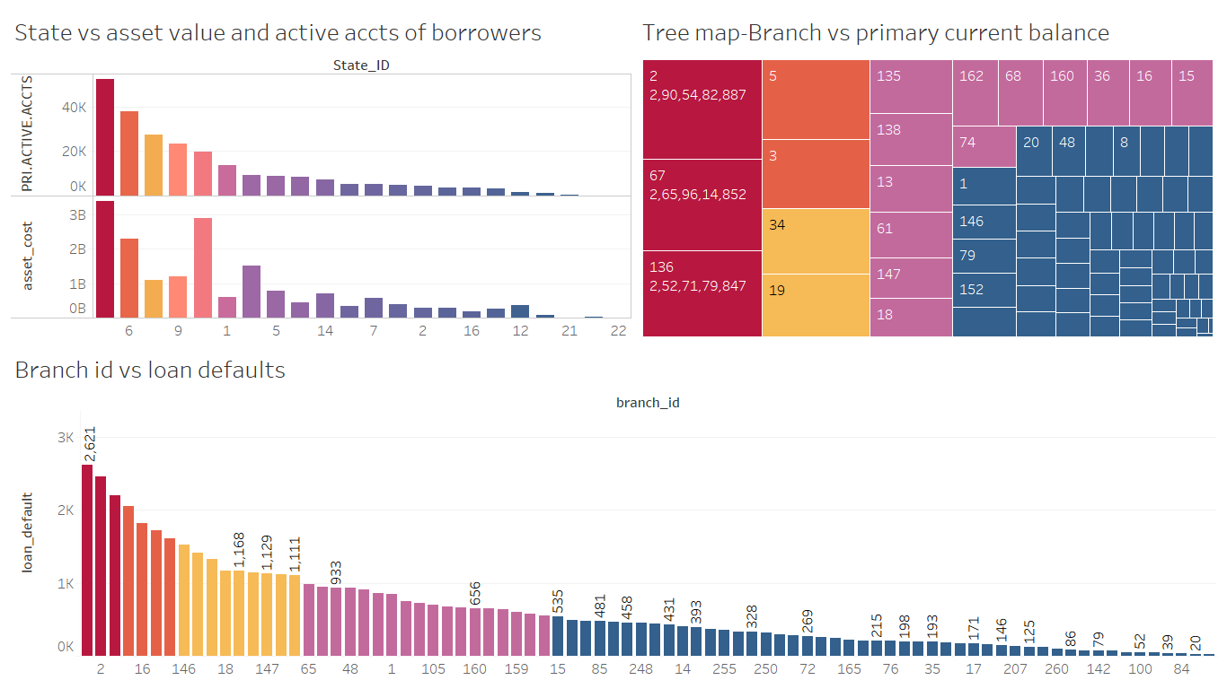
Branch With The Active Users

Slide 9
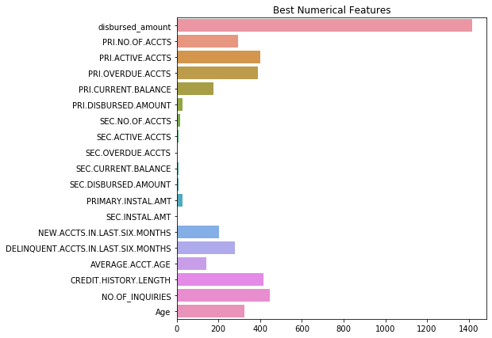
Statistical significance of Numerical variables

Slide 10
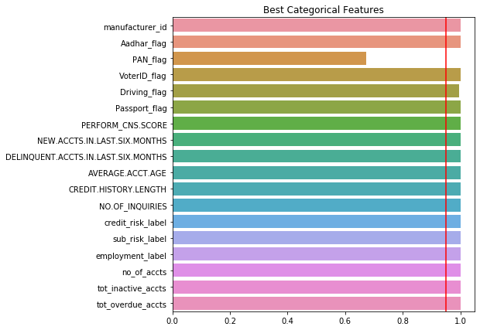
Statistical significance of Categorical variables

Slide 11
Model Building
1. Transformations :
Yes . Since the data is not normally distributed (Highly right skewed), We tried Log transform, Sqrt transform.
2. Scaling the data :
Yes, the data has been scaled. Also used Robust Scaler.
3. Dimensionality reduction :
Since there is no multicollinearity in our data presently(removed after checking VIF), We haven’t done PCA since resulted Principal Components was very low.
4. Added New Column to Describe Missing Features of each Customers

Slide 12
Model Performances
Model | Train | Test | Precision | Recall | F1
Logistic | 0.621 | 0.623 | 0.304 | 0.57 | 0.397
Decision Tree (Entropy) | 1 | 0.979 | 0.94 | 0.95 | 0.9522
Decision Tree(Gini) | 1 | 0.979 | 0.945 | 0.958 | 0.952
Random Forest | 1 | 0.953 | 0.953 | 0.827 | 0.885
Naïve Bayes | 0.577 | 0.583 | 0.263 | 0.512 | 0.348
Bagging Classifier | 0.999 | 0.981 | 0.964 | 0.949 | 0.9566
Adaboost | 0.885 | 0.859 | 0.636 | 0.821 | 0.717
XGBoost | 0.962 | 0.955 | 0.927 | 0.862 | 0.893

Slide 13
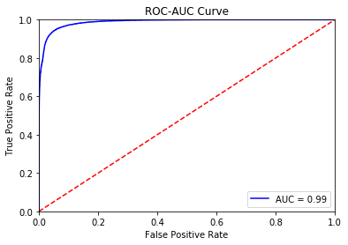
XGBoost Model Performance
Confusion Matrix
ROC-AUC Curve
 | Actual Defaulters | Predicted Non-Defaulters
Predicted Defaulters | 13096 | 1027
Predicted Non-Defaulters | 2095 | 53729

Slide 14
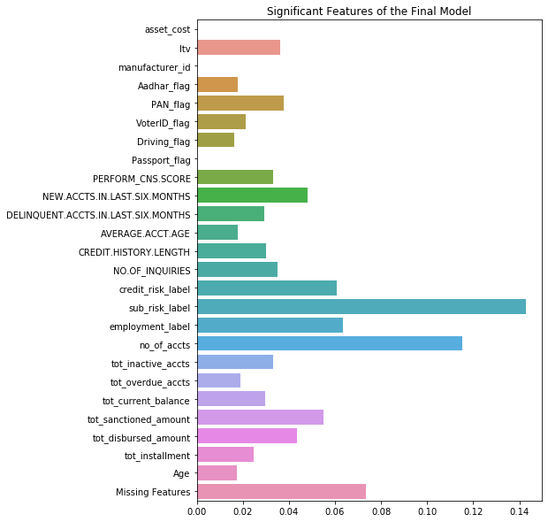
Business Interpretations

Slide 15
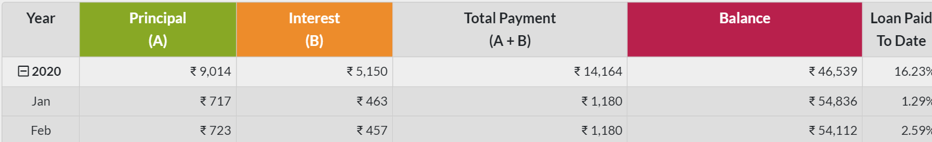
Profit Generated from Loans
Median Sanctioned Amount -> Rs. 55553
Rs. 1180
Monthly EMI Amount
Principal Part of EMI
Interest Part of EMI, which is the Bank’s Income
Rs. 717
Rs. 463

Slide 16
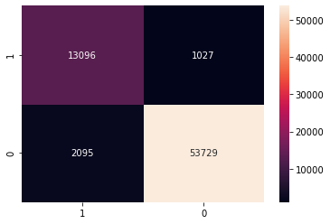



Return on Investment
Actual
Potential Customers that are excluded by our model.
Predicted
Bank’s income from one borrower : Rs 463
Without model -> 2,53,52,028(Profit)
- 70,33,433(Loss)
Net Profit = 1,83,18,595
With our model -> 2,48,76,527(Profit)
- 9,69,985 (Loss)
- 4,75,501 (Loss)
Net Profit = 2,34,31,041
Non-Potential Customers that are given loan by our model.
50,00,000 more profit.
% profit increased = 0.167

Slide 17
Thank You

